Slide 1
IEM Events App
Girish Garg, Aritra Sen
[Project Group ID - 40]

Slide 2

OBJECTIVE
Aimed at providing one-click access to all event updates at college

Slide 3

Motivation
Fests
Club Events
Workshops
Conferences
Seminars

Slide 4
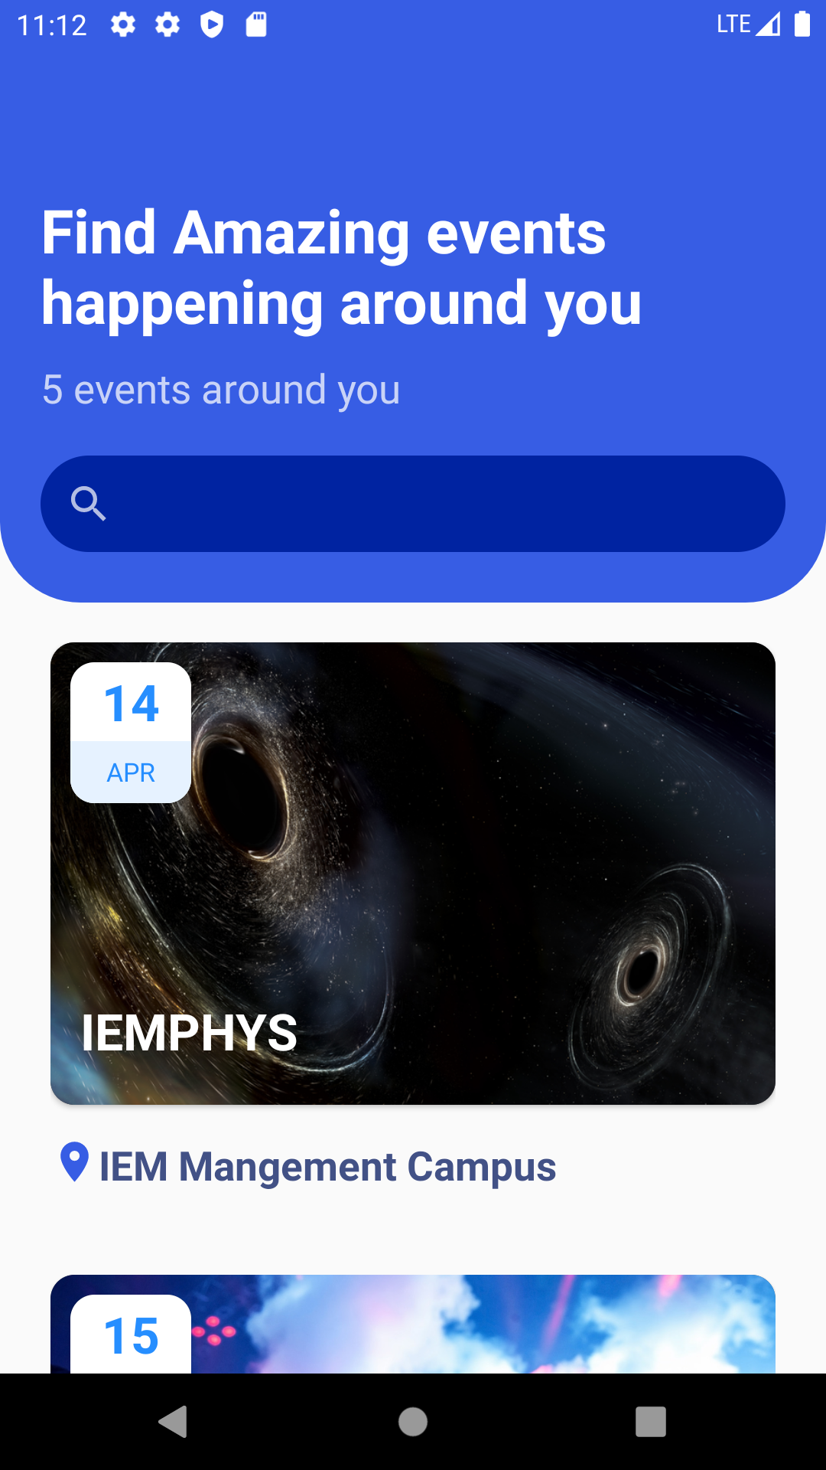
Demo
Search for events
Date
Event title
Venue

Slide 5
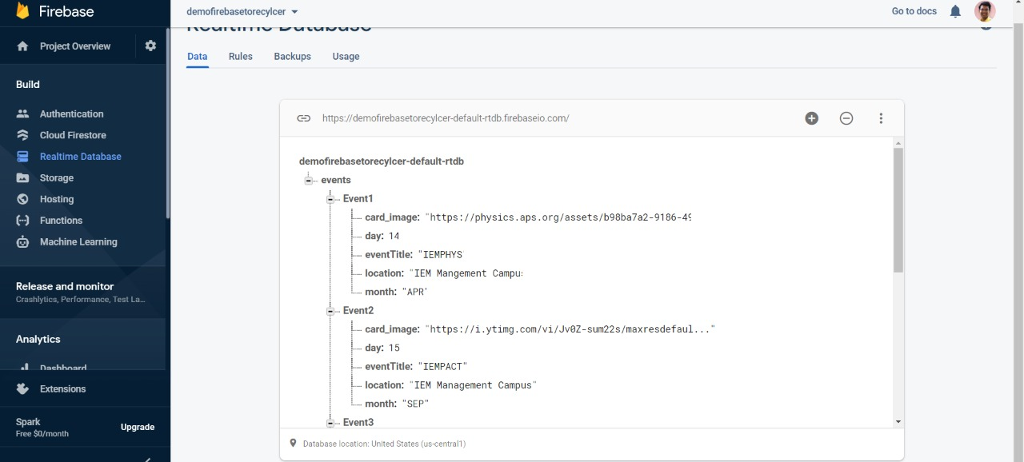
Datebase

Slide 6
Features
Easy UI/UX
View all events at one place
Search for any event
Create, edit or delete events
Bookmark favourite events

Slide 7
Future Prospects
Event registration
Bookmark favourite events
Maintain entry/exit of users using QR Code
Notification for upcoming events

Slide 8
THANK YOU

